Slide 1

EOSC - Connecting to Communities - just a few thoughts -
Peter Wittenburg
Max Planck Computing & Data Facility

Slide 2
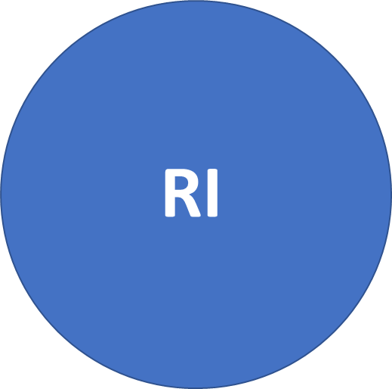

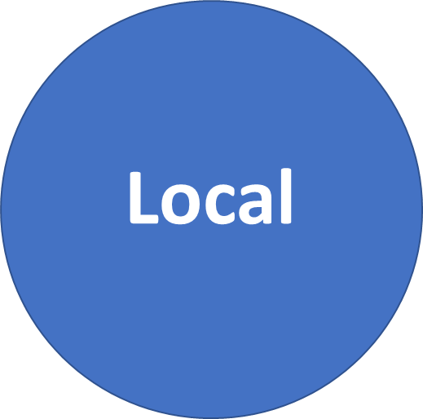

EOSC Situation
Individuals?
eInfra
EOSC
DS
1.000s of repositories
10.000s of registries
100.000s of tools
RO
EOSC is (too) complex or?
poor Data Scientists are overwhelmed!
no one simple solution to connect!
do we share ambitions (5 y – 100 y)?
do we have a vision for integration?
do DS trust all this and invest?

Slide 3
Ideal Solution
Run a survey in GEDE ESFRIs:
abstraction process realistic?
discussions in the clouds far away from DS
DS don‘t feel represented
there is a layer of „EOSC experts“ who talk, run surveys and get funds, DS don‘t have time to participate
there is a „power game“
is this sufficient?
hope on
abstraction
EOSC
Clusters
Governance in place:
two Boards
5 WGs
many „EOSC projects“
many new faces / some known
of course: interests involved
ESFRIs/ERICs
ESFRI Partners & Outreach
many more out there (RI, RO, DS, etc.)

Slide 4
Technology Driven Activities
learned a lot
educated many people
no abstraction
learning a lot
educating many people
no abstraction
G. Strawn:
Interoperability is good for Science, but bad for
scientists since it costs time.
Scientific
Project
Scientific
Project
Scientific
Project
Scientific
Project
Scientific
Project
Scientific
Project
Scientific
Project
Scientific
Project
abstraction
who?
how?
Scientific
Project
abstraction
- virtualisation
- object stores
Scientific
Project
Grid
Movement
Cloud
Movement
?

Slide 5
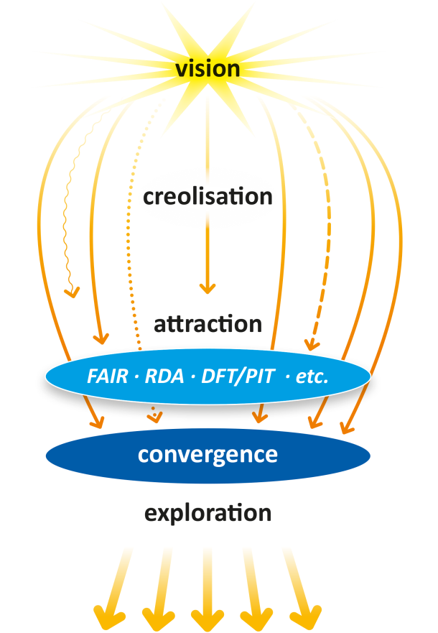
About Convergence
Degree of Complexity is high
Some eternal principles:
reduce complexity by convergence
use the principles of abstraction and encapsulation – this requires stable binding
take care of referential integrity over decades
EOSC
do „we“ share these principals?
do they play a role in EOSC discussions?
my answer is yes & no
FAIR principles are a step to convergence
RDA outputs could be steps – need a message
Turning FAIR into Practice Report: FAIR DOs
but some start with services such as EOSC Portal
Computer Networking
Data Domain
IP
?
Common Patterns in Revolutionary Infrastructures and Data
http://doi.org/10.23728/b2share.4e8ac36c0dd343da81fd9e83e72805a0

Slide 6
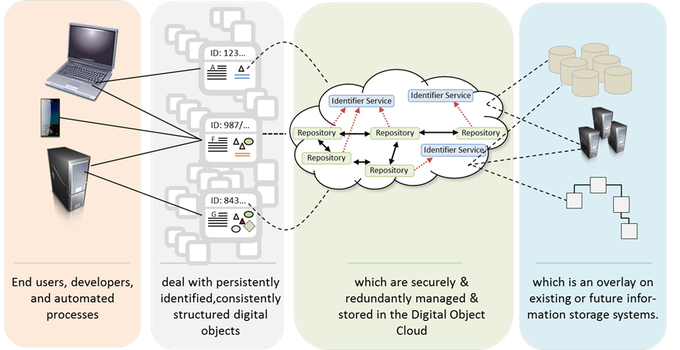
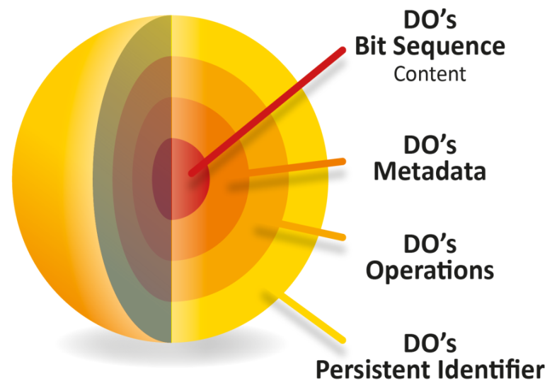
FAIR DOs
Embedded in the FAIR DO Concept
abstraction
encapsulation
stable binding
referential integrity over decades is primarily a social matter
is it something for EOSC?

Slide 7

Need a Momentum to Change
Without a unifying message we will talk forever
and continue with our silos.

